Slide 1
Consultas Select
Jairo Rivera Céspedes

Slide 2
Select
SELECT column1, column2, ... FROM table_name;
SELECT * FROM table_name;

Slide 3
Select where
SELECT column1, column2, ... FROM table_name WHERE condition;

Slide 4
Select AND
SELECT column1, column2, ... FROM table_name WHERE condition1 AND condition2 AND condition3 ...;

Slide 5
Select OR
SELECT column1, column2, ... FROM table_name WHERE condition1 OR condition2 OR condition3 ...;

Slide 6
Select NOT
SELECT column1, column2, ... FROM table_name WHERE NOT condition;

Slide 7
Select TOP
SELECT TOP number|percent column_name(s) FROM table_name WHERE condition;

Slide 8
Select MIN
SELECT MIN(column_name) FROM table_name WHERE condition;

Slide 9
Select MAX
SELECT MAX(column_name) FROM table_name WHERE condition;

Slide 10
Select COUNT
SELECT COUNT(column_name) FROM table_name WHERE condition;

Slide 11
Select AVG
SELECT AVG(column_name) FROM table_name WHERE condition;

Slide 12
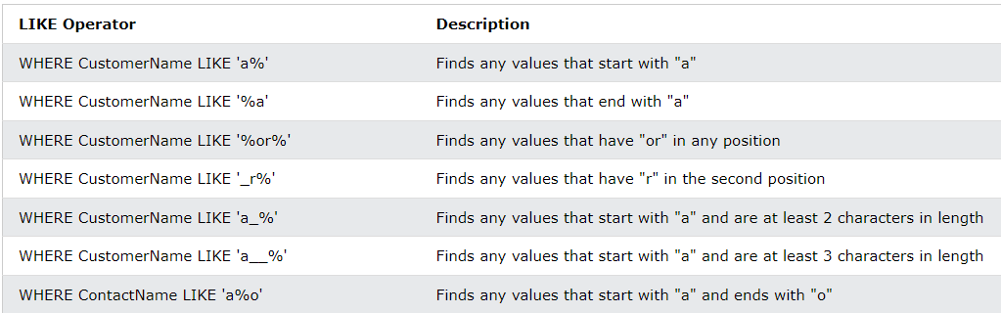
Select like
SELECT column1, column2, ... FROM table_name WHERE columnN LIKE pattern;

Slide 13
Select IN
SELECT column_name(s) FROM table_name WHERE column_name IN (value1, value2, ...);

Slide 14
Select BETWEEN
SELECT column_name(s) FROM table_name WHERE column_name BETWEEN value1 AND value2;

Slide 15
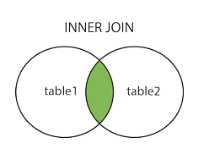
INNER JOIN
Cuando hacen match en ambas tablas

Slide 16
INNER JOIN
SELECT column_name(s) FROM table1 INNER JOIN table2 ON table1.column_name = table2.column_name;

Slide 17
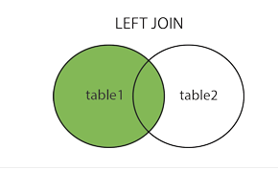
LEFT JOIN
Cuando hace match pero solo coloca los valores de la izquierda

Slide 18
LEFT JOIN
SELECT column_name(s) FROM table1 LEFT JOIN table2 ON table1.column_name = table2.column_name;

Slide 19
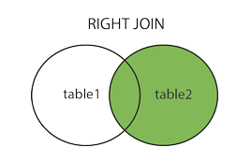
RIGHT JOIN
Cuando hace match pero solo coloca los valores de la derecha

Slide 20
RIGHT JOIN
SELECT column_name(s) FROM table1 RIGHT JOIN table2 ON table1.column_name = table2.column_name;

